Slide 1

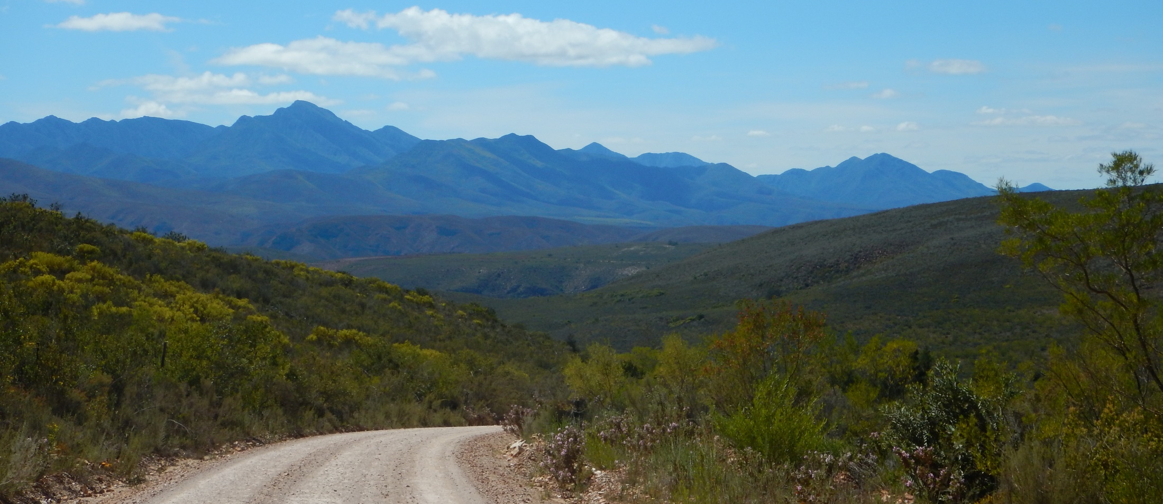

March 2018
Notes:
Welcome

Slide 2
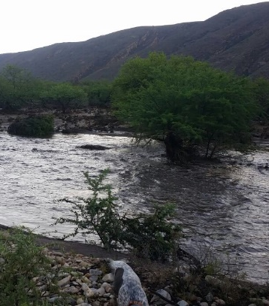
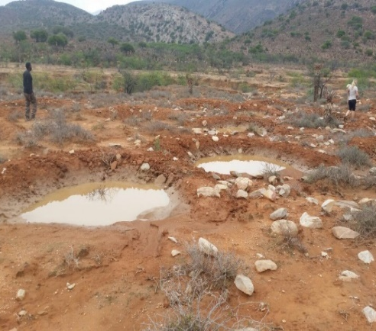
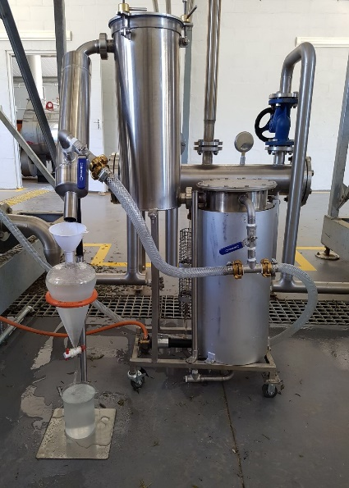
Baviaanskloof: Rain, Rehabilitation & Harvesting
Notes:
Good rains – rehab working!
6NRM/GIB teams
Harvesting lavindin & Rosemary

Slide 3
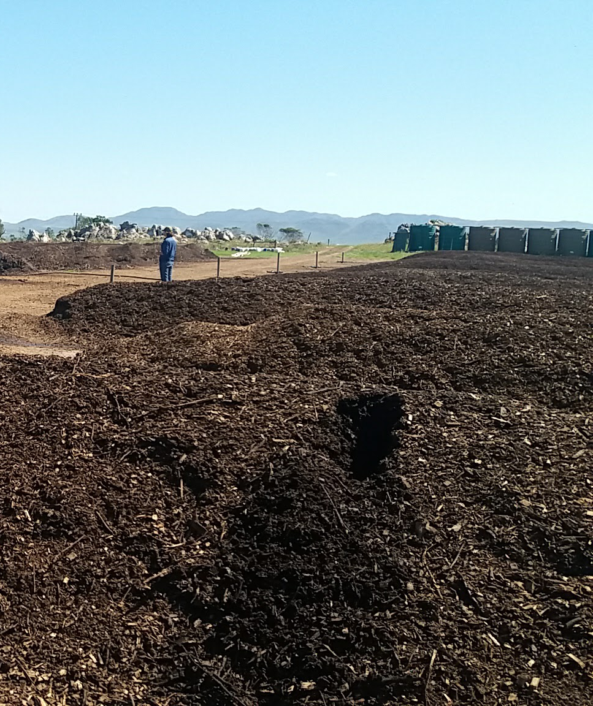
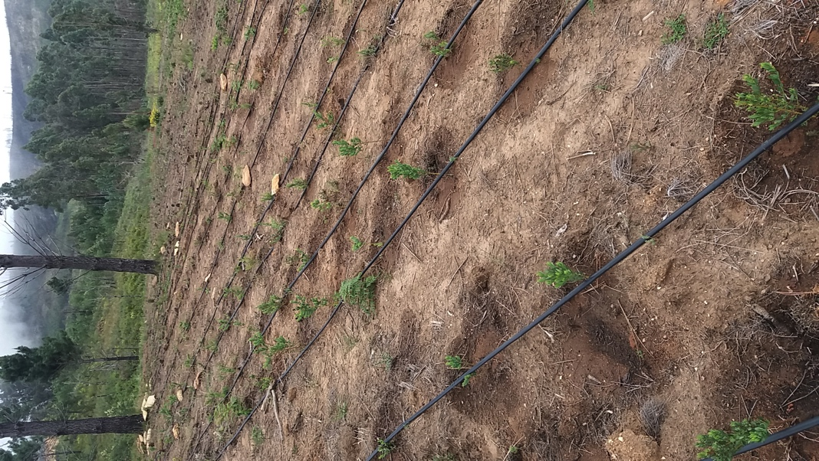
Langkloof: Compost Expert, Honeybush Trials
Notes:
Composting expert – trials in Haarlem – value adding; water wise agric, water security
HB Trials – well under way; continued engagements with stakeholders

Slide 4
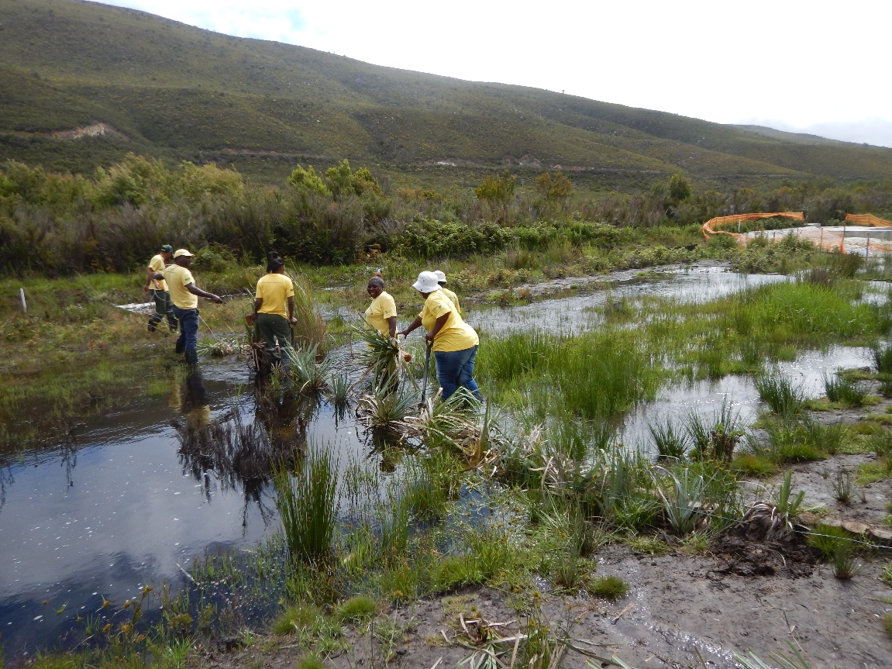
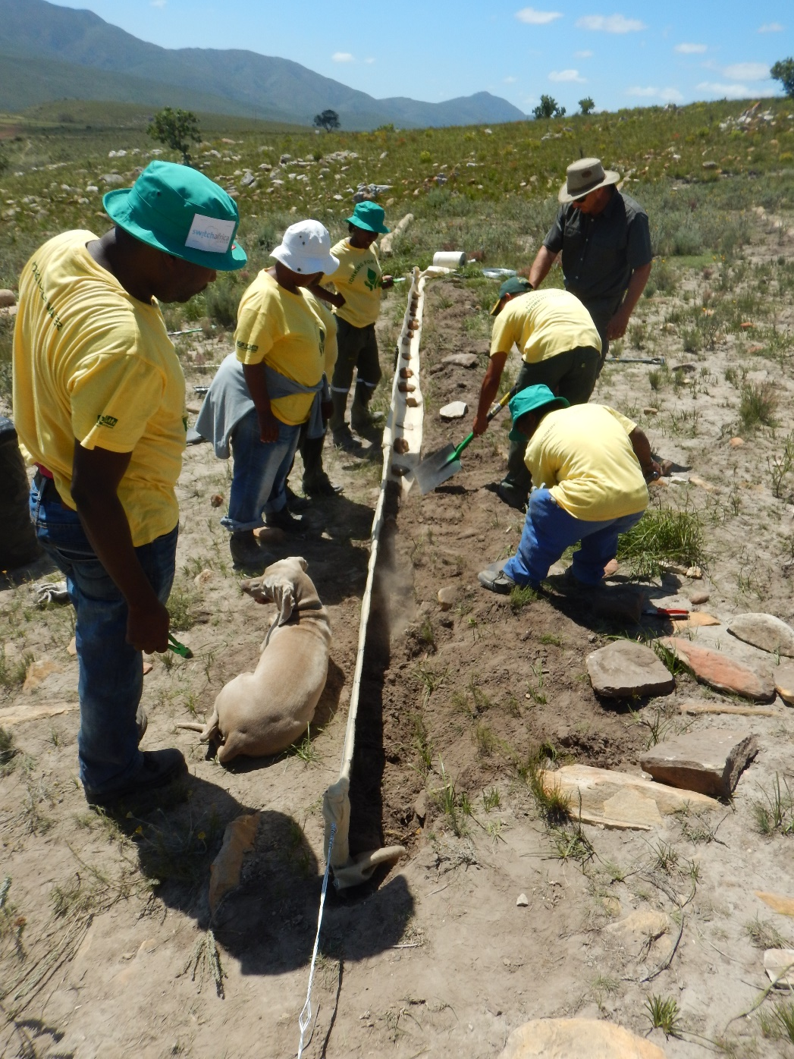
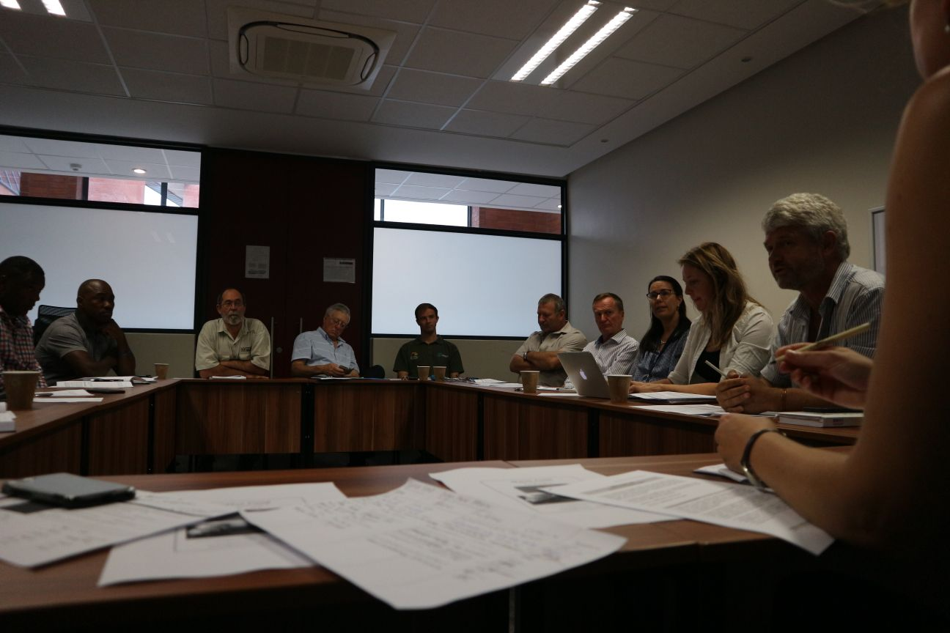
Langkloof: GIB collaboration, Water Fund
Notes:
Rehab collaboration with GIB – planting palmiet trials & dry land rehab course
Water fund – busy setting up Steering Commitee.

Slide 5
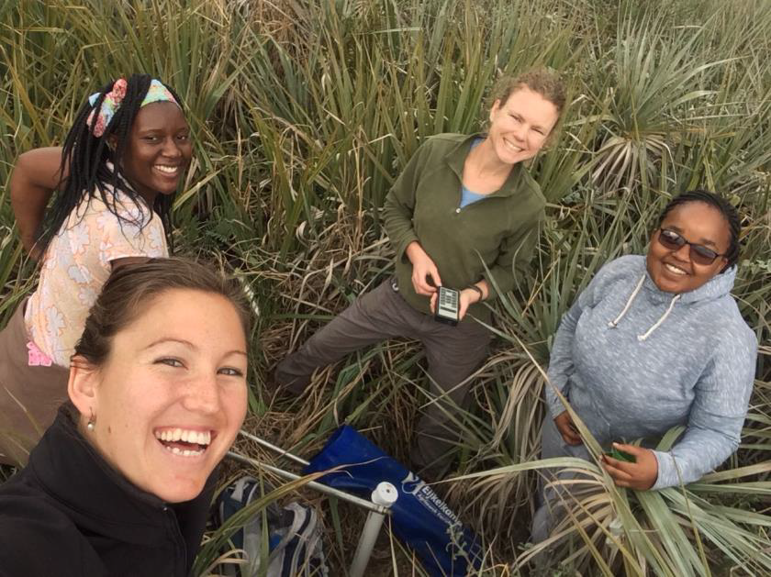
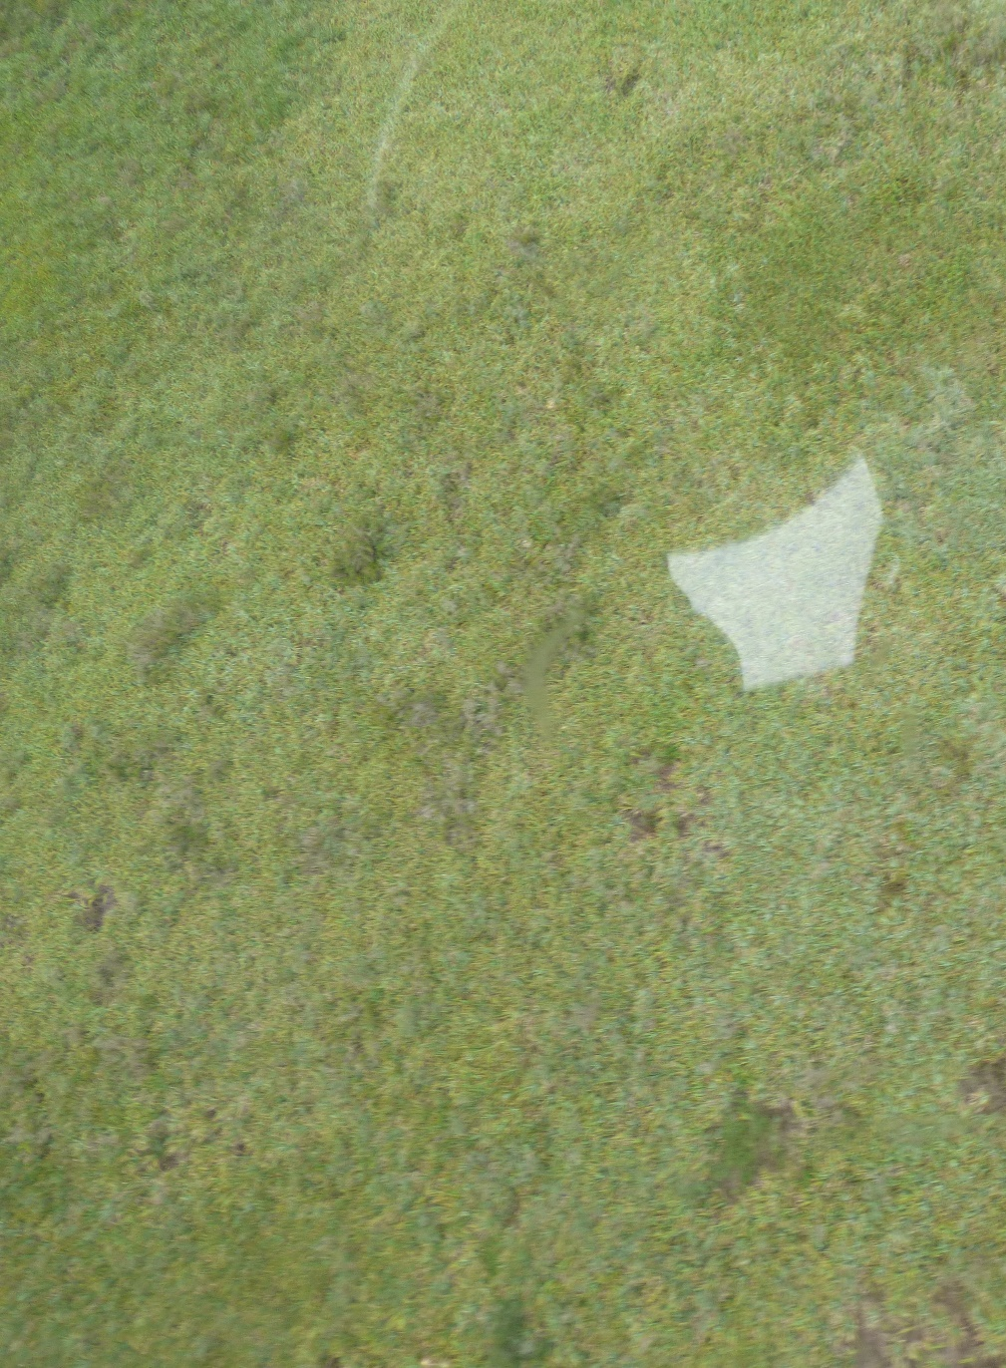
Langkloof & Baviaanskloof: WRC data gathering / focus more on building of model itself

Slide 6
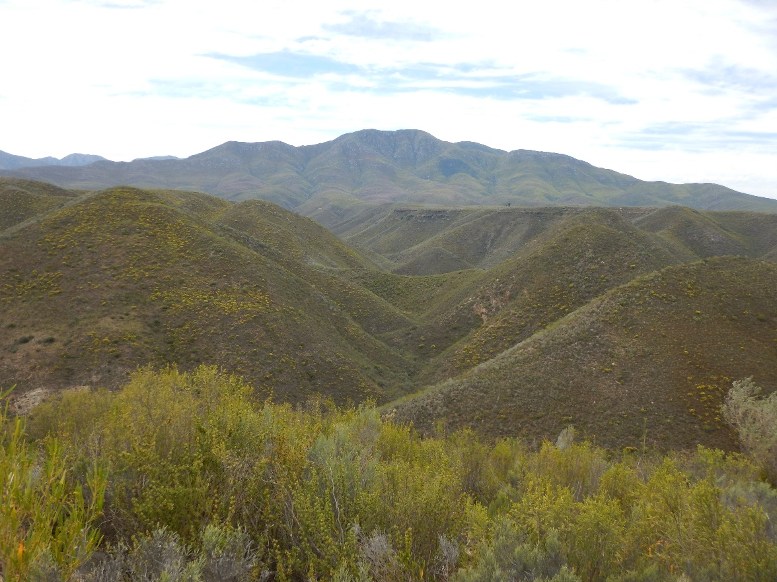
Thank You

